Slide 1




The Social Consequences of Job Crafting:
An Examination of Crafting Type
on Emotional and Behavioral Reactions
of Co-worker
ZHIjun Chen & Feifan Yang
Shanghai University of Finance and Economics

Slide 2

Social Consequences of Job Crafting
Feifan (Justin) Yang
2018-now Ph.D. student
Department of Human Resource Management
Shanghai University of Finance and Economics
Interests:
  Migrant/peasant workers;
  Future work design (job crafting)
Email: feifan159@outlook.com

Slide 3


Literature review
With the development of technologies and organizations, people pay more and more attentions to adapt to the changing environment, especially their complex workplace.
Against this background, the notion of job crafting has been proposed to shape and change the design and environment of employee’s own job. (Wrzesniewski & Dutton, 2001)
Employees craft their jobs to shape
relationship and interactions with co-workers. (Wrzesniewski & Dutton, 2001)

Slide 4

Literature review
The notion of job crafting has been proposed to shape and change the design and environment of employee’s own job (Wrzesniewski & Dutton, 2001)
Employees cannot perform their tasks isolated from their colleagues completely, because in most workplace settings employees interact and collaborate with group members (Grant & Parker, 2009)
So, colleagues’ evaluation is important.

Slide 5

Literature review
More recently, a few studies have tested the influence of individual job crafting to colleagues including well-being, job characteristic or work engagement (Bakker, Rodríguez-Muñoz, & Sanz Vergel, 2016; Demerouti & Peeters, 2018; Tims, Bakker, & Derks, 2015)
Almost all of the works from interpersonal perspective tested the vicarious impact – colleagues are impact by witnessing and learning from the crafter’ behaviors (see Bakker et al., 2016; Demerouti & Peeters, 2018; Peeters, Arts, & Demerouti, 2016)
Unfortunately, few researches have been conducted to explore colleagues’ evaluation of crafter

Slide 6

Literature review
colleagues’ evaluation —— which would help employees to understand the social consequences of job crafting and consider potential co-worker reactions into their decision to craft
Therefore, we focus on the dyad relationship and explore the underlying
mechanisms between employee’s job crafting and colleague’s direct reactions toward crafter.

Slide 7
Approach V.S. Avoidance
We explore how engagement in
approach job crafting versus avoidance job crafting – that is, craft toward improvement-based and problem-focused goals versus reducing or eliminating part of one’s work (Bruning & Campion, 2018)
Several terminologies of job crafting have been proposed (e.g., Bindl et al., 2019; Oprea et al., 2019), the approach-avoidance distinction is the most relevant and more systematic (Zhang & Parker, 2019)

Slide 8

Theoratical perspective
Social comparison theory (SCT; Festinger, 1954)
Since job crafting was defined as the changes to improve employee’s own job (Bruning & Campion, 2018), and as “everyday behavior” (Wrzesniewski & Dutton, 2001), we argue that colleagues are inclined to compare themselves with crafter (Kulik & Ambrose, 1992).
As workers craft with the intention to improve their job (Bruning & Campion, 2018) and increase person-job fit personally (Tims, Bakker, & Derks, 2012), they can create better situations between employees in the workplace. —— a co-worker is more likely to engage in upward social comparison (Brown et al., 2007; Festinger 1954)

Slide 9


Envy & Admiration
When people compare themselves with someone who has a better situation, people can experience two key emotions —— envy and admiration (Van de Ven, 2017).
social comparison theory assumes that two distinct processes —— a cognitive (i.e., deservingness) and an emotional one (i.e., pleasantness) – result in different emotions (e.g., Marescaux, De Winne, & Rofcanin, 2019; Van de Ven, Zeelenberg, & Pieters, 2011b)

Slide 10
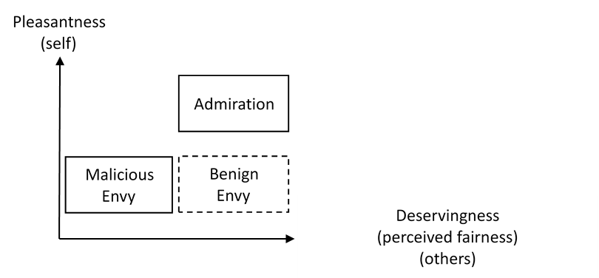
Theoratical perspective
When a parterner views the actor’s better position is deserved and feels pleasant, the parterner is more likely to admire this employee.
When a colleague thinks the actor’s better position is undeserved and feels unpleasant, the colleague will feel malicious envy.

Slide 11
Hypotheses Development
Avoidance job crafting with the intentions to evade, reduce, or eliminate
part of one’s work (Bruning & Campion, 2018)
Avoidance crafting reflects reduction of hindering job demands (Tims et al., 2012), and one’s work role (Wrzesniewski & Dutton, 2001).
From the colleague’s perspective, the change of crafter may produce more workloads for them.
Hypothesis 1a. Avoidance job crafting is positively related to co-worker malicious envy.

Slide 12
Hypotheses Development
Approach crafting may result from coping with challenge stressors actively (Bruning & Campion, 2018), increasing job resources or job demands (Tims et al., 2012).
In a word, crafter earns the results, such as better performance, work engagement.
When an individual proactively takes more work roles or increases social interactions to fulfill his/her work, it can be helpful and efficient to work with this person.
Hypothesis 1b. Approach job crafting is positively related to co-worker admiration.

Slide 13
Dependent variable
Hypothesis 2a. Co-worker malicious envy mediates the relationship between avoidance job crafting and ostracism.
Hypothesis 2b. Co-worker admiration mediates the relationship between approach job
crafting and altruism.

Slide 14
Hypotheses Development
Considering the centrality of the self in social comparison processes (Tai, Narayanan, & McAllister, 2012), the emotional reactions toward a group member not only result from the crafter’s behaviors themselves, but also from the individual differences of the reactor.
Gender is one of the most basic and significant characteristics used to class individuals (McClean et al., 2018).

Slide 15
Hypotheses Development
Prior research has shown that women are thought to develop an interdependent self-construal, whereas men are more likely to construct an independent self-construal (Cross & Madson, 1997).
Women with an interdependent self-construal are more likely to be assimilated with others (Cross & Madson, 1997).
Correspondingly, female colleagues will give avoidance crafter less malicious envy than male colleagues.

Slide 16
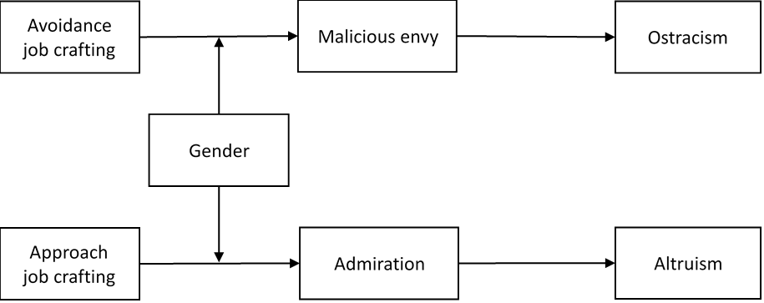
Hypotheses Development
Hypothesis 3a. Gender moderates the indirect effect of avoidance job crafting on coworker ostracism via malicious envy, such that the relationship is stronger for men than for women.
Hypothesis 3b. Gender moderates the indirect effect of approach job crafting on coworker altruism via admiration, such that the relationship is stronger for women than for men.

Slide 17
Scenario Study
141 MBA students;
38% female;
31.20 years old (SD=3.78);
Randomly assign to five conditions.

Slide 18
Scenario Study
Five conditions: (adopted from (Brunning & Campion, 2018))
1) CONTROL: “Most of LI's job is to input and check data, and he/she has mastered these skills.”
2) ROLE EXPANSION: “At some point, LI decided to express opinions on important topics during team meetings, such as product design and positioning, which will increase his/her work content and role to ensure the quality of the work he/she is responsible for.”
3) ROLE REDUCTION: “At some point, LI decided to skip some jobs that require a lot of time in order to reduce his/her workload. During team meetings, sometimes he/she will ask someone else to attend the meeting instead of him/her.”

Slide 19
Scenario Study
4) SOCIAL EXPANSION: “At some point, LI decided to communicate with other participants on the team, which improves the quality of his or her communication with other researchers while actively developing his or her own professional network.”
5) SOCIAL REDUCTION: “At some point, LI decided not to communicate with other participants on the team, which makes it impossible to keep track of the progress of the project and communicate better with the other study participants when dealing with the business.”

Slide 20
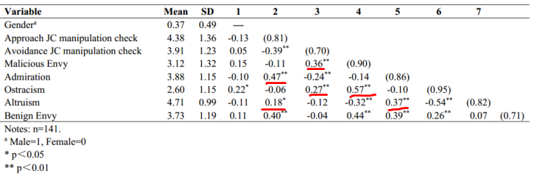
Scenario Study
Results:

Slide 21
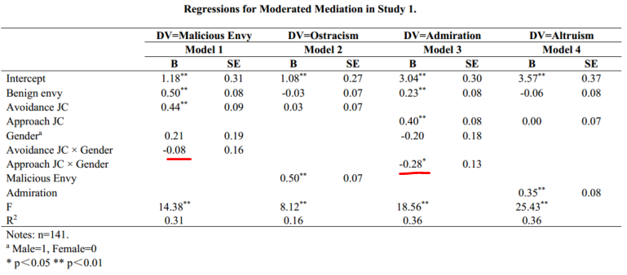
Scenario Study
Results:

Slide 22
Scenario Study
Results:
H 1a, 1b, 2a, 2b and 3b was supported
H 3a was not supported.

Slide 23
Thank you!
Email: feifan159@outlook.com

