Slide 1
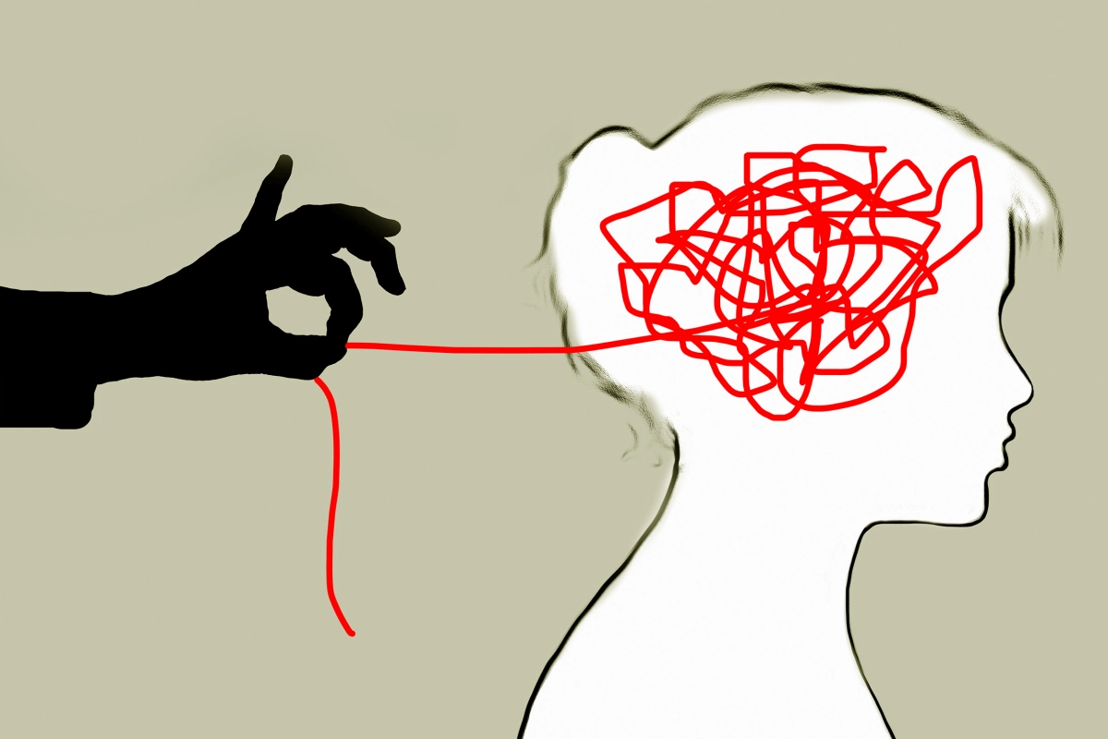




Emonet 2020
The Emotions of Failure in Organizational Life
Roy Smollan & Smita Singh
Auckland University of Technology, New Zealand

Slide 2
Contents
Failure is widespread in multiple areas of life
Research into failure across management domains
Definitions of failure
Failing and failure
The emotions of failure
The consequences of the emotions of failure
Dimensions of the emotions of failure
Other factors influencing emotional reactions to failure
Limitations, further research directions, conclusions

Slide 3


Failure during the Covid pandemic – and afterwards???
It soon became apparent that the virus revealed failures in governments, institutions, industries and organisations to anticipate major problems and rapidly adjust to them. For some it was their own fault, for others much was beyond their control.
At the organisational level changes have occurred that enabled some to benefit (e.g., manufacturers of masks, supermarkets, online deliveries and entertainment) while others have failed significantly.
At the individual level, many have lost their jobs, others their businesses (and NGOs) – or fear that they will.
Stress levels are at an all-time high. Negative emotions and moods have escalated and vary over time.
As countries have relaxed restrictions, cases and deaths have begun to mount = more failure, more stress.

Slide 4
Failure research across management disciplines
Organizational studies
Organizational behaviour
Organizational change
Strategy
Entrepreneurship
Leadership
Careers
Vaara, 2002
Cannon & Edmonson, 2001
De Keyser et al., 2019
Jiang et al., 2017
Singh et al., 2007, 2015
Giessner & van Knippenberg, 2008
Heslin, 2005
next slide
Within each discipline, there are different conceptualizations and definitions of failure.

Slide 5
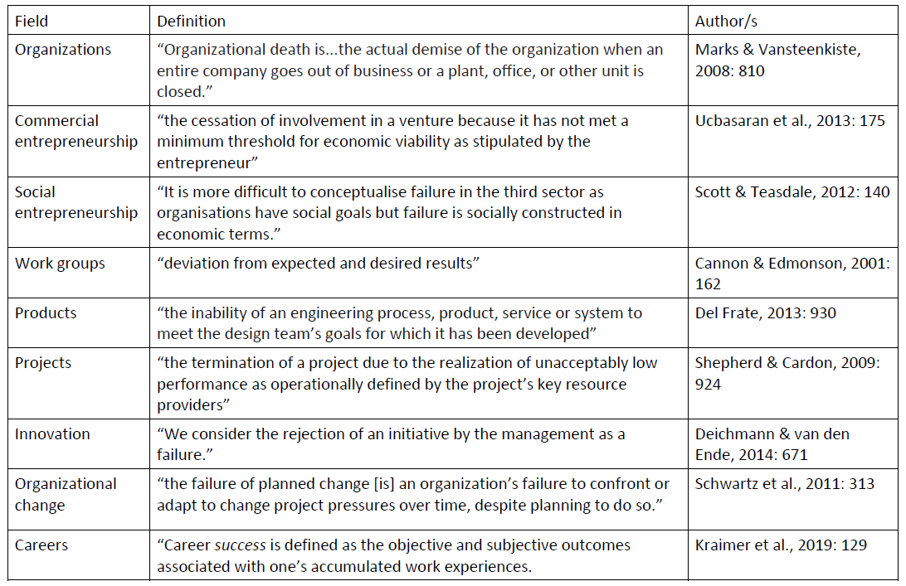
Table 1. Definitions of failure across domains

Slide 6



Failure and emotions
Failure is an affective event (He et al., 2018).
Naturally, most of the emotions are negative ☹ but some may be positive ☺. Both could occur while failure is unfolding and afterwards.
Negative and positive emotions can have negative and positive consequences for the individual, other people and the organization.
Emotional intelligence, and particularly emotional regulation, help people to stop or slow downward trajectories (material and psychological), and possibly ‘land’ safely.

Slide 7
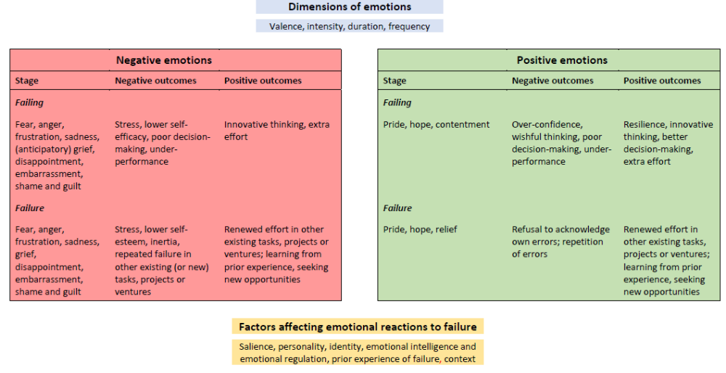
Figure 1: Model of the emotions of failure in organizational life

Slide 8
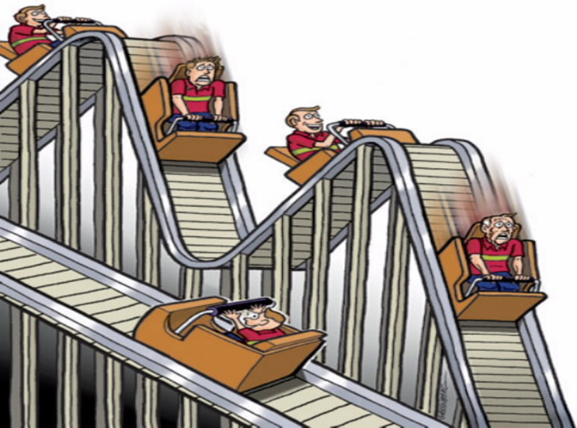
Failing and failure
Failing is a process that occurs over time as the individual perceives problems occurring that could derail the organization, venture, project, change, etc.
Failure is the outcome – usually final but not always. (Organizations that have failed may be sold to others who make them work; strategies that seemed to have failed may, over time, prove successful; discarded changes may be resurrected and modified – and work!).
The emotions of failing and failure may be similar and different and oscillate over time.

Slide 9

The negative emotions of failure
Some examples
The emotion depends on perceptions of who or what is to blame (Cardon et al., 2011), e.g., frustration, anger if it is due to others; guilt, shame, embarrassment if it is the individual’s lack of foresight, ability). (Doern & Gross, 2013)
Grief of loss – anticipated and experienced occurs regardless of causes of failure. (Jenkins et al. 2014)
There are also cultural differences in how failure is experienced and the emotions that may result from perceived the perceived stigma. (Singh et al., 2015)
There are also contextual differences. For example, the pandemic – and it consequences – may leave us feeling worried and sad, but we may see believe that our failure was just bad luck, and not too different from the impact of droughts, floods and earthquakes.
Failing
Fear, anger, frustration, sadness, (anticipatory) grief, disappointment, embarrassment, shame and guilt
Failure
Fear, anger, frustration, sadness, grief, disappointment, embarrassment, shame and guilt

Slide 10

The positive emotions of failure
Some examples
Failing
Pride: I am trying to make it work.
Hope: Maybe it will still succeed.
Contentment: If it does succeed.
Failure
Pride: I gave it my best shot!
Hope: Some good may have come from my/our efforts.
Relief: Thankfully it’s over!
The emotion partly depends on an optimistic outlook. (Moenkemeyer et al., 2012).
The emotion partly depends on the ability to look for the silver lining, or to exercise self-compassion. (Shepherd & Cardon, 2009).

Slide 11
The consequences of the emotions of failure
“When it can be good to feel bad and bad to feel good”
(Lindebaum & Jordan, 2014)
Negative emotions | Negative consequences | Positive consequences
Positive emotions | Negative consequences | Positive consequences

Slide 12
Negative emotions and their consequences
Negative consequences
Positive consequences
Failing
Instead of taking action to prevent failure or mitigate its outcomes, people may doubt themselves, lose motivation, become paralyzed or make poor decisions, contributing to a downward spiral of despair and ‘self-sabotage and paralysis’. (Edwards & Ashkanasy, 2018)
Failure
More negative emotions arise as reality bites and the perceived material and reputational losses mount. Feelings of grief (Bell & Taylor, 2011; Jenkins et al., 2014), as well as stigma (Singh et al., 2015) are possible. We are struck by inertia for shorter or longer periods.
Failing
Emotions facilitate thinking. (Salovey & Mayer, 1997)
Fear of failure can improve performance. (Cacchiotti et al., 2016; Gill & Burrow, 2018)
Guilt and embarrassment may drive innovative thinking and constructive action to resurrect the organization/strategy, etc., mitigate losses.
Emotional regulation and quick adaptation help to attenuate the damage. (He et al., 2018)
Failure
Renewed effort in other existing tasks, projects or ventures; learning from prior experience, seeking new opportunities.
(Cope, 2011; Deichmann & van den Ende, 2014)

Slide 13
Positive emotions and their consequences
Negative consequences
Positive consequences
Failing
Over-confidence, complacency, wishful thinking, poor decision-making, under-performance: People refuse to face reality, ignore danger signs, hope for the best without taking corrective action. (He et al., 2018)
Failure
Self-compassion, misplaced pride and contentment may lead to refusal to acknowledge own errors and repetition of errors in other tasks and ventures or new ones. Failure repeats itself because lessons have not been learnt. (Ucbasaran et al., 2013)
Failing
Pride may lead to innovative thinking and extra energy, focused on constructive action.
Hope offers a beacon of light to save a failing venture.
Positive emotions buffer the effects of stress. (Frederickson & Joiner, 2017)
Failure
Hope and optimism lead to engagement in new ventures and/or other existing activities. (Jenkins et al., 2014)
“We minimised everybody’s [losses]…I was very proud of what we did.” (reported by Cope, 2011)

Slide 14



Dimensions of the emotions of failure and their consequences
Valence: Usually characterized as negative/positive depending on perceived outcomes, material and psychological.
Intensity: Some people who experience failure, or impending failure, will respond with varying degrees of intensity, mostly based on the salience/importance of the venture, change initiative, etc. to them and the impact on them.
Duration: Negative emotions that last a long time may have a corrosive impact on the individual’s wellbeing (van der Kaap-Deeder et al., 2016). Positive emotions are less likely to last.
Frequency: If negative emotions occur frequently they are likely to have a debilitating effect; positive emotions may lead to complacency and inertia. Emotions may morph into moods (Russell, 2003) and lead to rumination (Wilhelm et al., 2014).
☺
☹☹☹…
☺☺☺ …

Slide 15
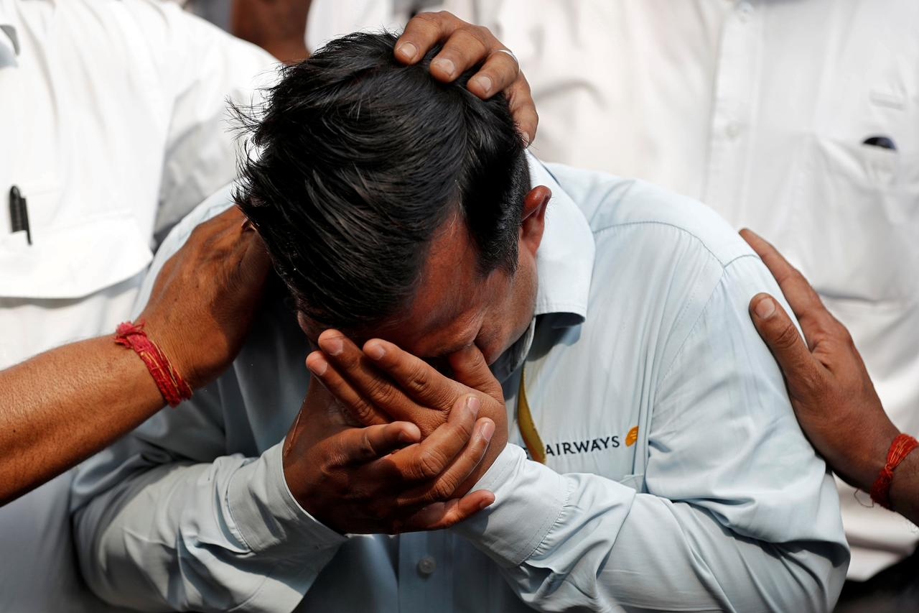
Other factors influencing emotional reactions to failure
Salience
The more important the perceived outcomes of failure are, the more intense the emotions will be, the longer they are likely to occur and the higher the frequency is likely to be. (Singh et al., 2015)
Personality
Those higher in negative affectivity, neuroticism and perfectionism are likely to experience the negative emotions of failing/failure. (Kaplan et al., 2009; Edwards & Ashkanasy, 2018)
Positive affectivity and dispositional optimism may lead to different perceptions of failure, and more muted positive emotions. (Renn et al., 2011)
Identity
Self-identity, role identity, social identity and organizational identity are compromised by failure. “Academic failure felt like the death of a substantial part of my identity – and I sincerely believed the best possible outcome was for the rest of me to die along with it” (cited in Edwards & Ashkanasy, 2018)

Slide 16


Other factors influencing emotional reactions to failure
Emotional intelligence and emotional regulation
EI allows people to understand and manage their emotions and respond appropriately to those of others when experiencing failing/failure. (Salovey & Mayer, 1997)
Emotional regulation (one aspect of EI) helps people to “Keep calm and carry on.” (He et al., 2018)
Prior experience of failure
Some people who have experienced failure before could be better prepared psychologically for the new failure; for others, repeated failure further erodes self-efficacy and the capacity to cope with negative experiences and emotions. (Jenkins et al., 2014; Shepherd & Cardon, 2009)
Context
Cultural attitudes to failure and stigma, the causes of failure, financial resources and other factors influence the nature of the emotions and the ability to manage them. (Singh et al., 2015)

Slide 17

Limitations, further research, conclusions
Limitations and further research
Literature across multiple sub-disciplines of management (and other fields) has seldom attempted a broad sweep of domains, types of failure, the emotions experienced and their consequences.
In doing so, however, as this paper has tried to do, discrete emotions have probably been treated too lightly and the comparison across disciplines, domains and contexts has not been attempted. The field is therefore open!
Conclusions
Failure is common but no-one likes to fail; therefore we need to understand our emotional reactions to failure - and those of others.

Slide 18
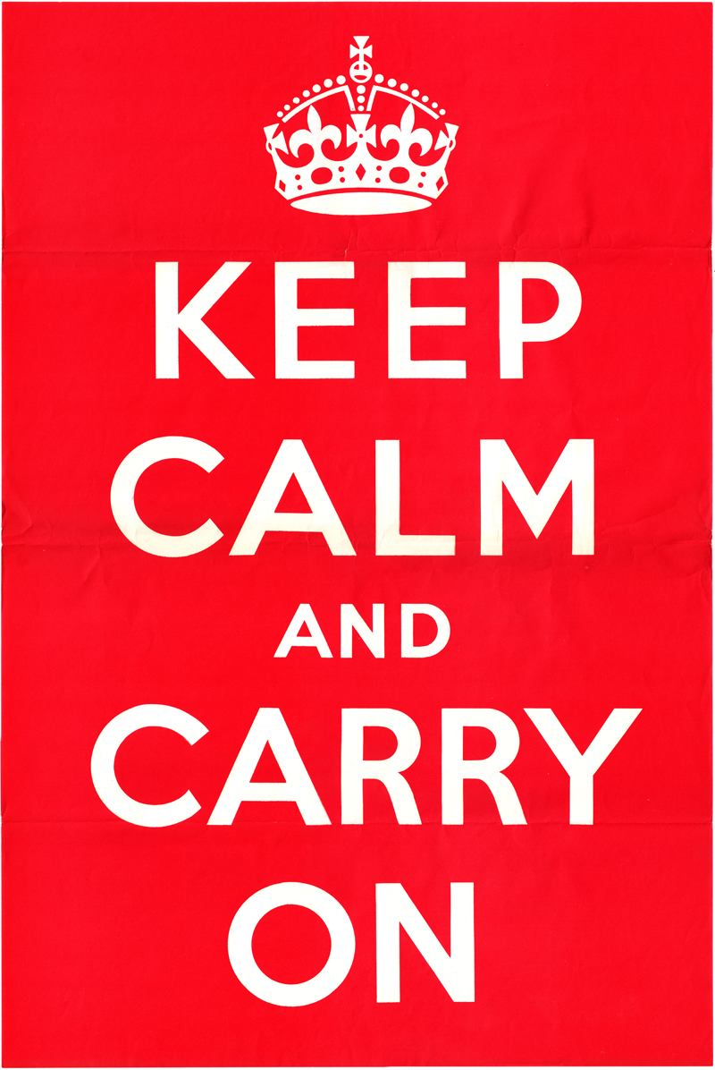

So, when facing failure…
And to use a Maori New Zealand term…
Keep strong!

