Slide 1


Two minutes to midnight: Unpacking organizational responses to the existential risk of biodiversity loss
Saheli Nath
Assistant Professor, College of Business

Slide 2

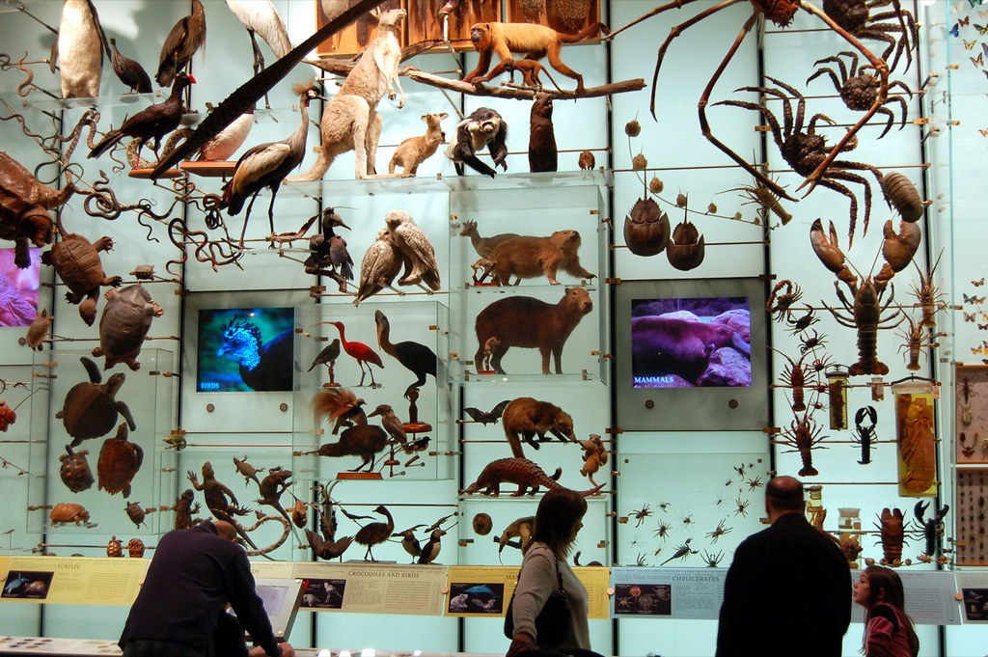
Agenda
Introduction & Research motivation
Theoretical Framework & Methods
Results
Conclusions
© 2019 Saheli Nath
Notes:
Last 10 minutes- form groups

Slide 3
Introduction
Biodiversity
  is defined as “the total variety of life (i.e., all species of plants, animals, fungi, and microbes) including genetic, population, species and ecosystem diversity, and the ecological roles and interrelationships (e.g., predator–prey) among organisms in biological communities” (Kim & Bryne, 2006).
Biodiversity loss
  Is often characterized as a “wicked” problem (Rittel & Weber, 1973)
  Complicated by the fact that there is no universally accepted definition of “biodiversity” and therefore no accurate way to measure its loss
  In popular media, biodiversity loss is often portrayed as endangerment of mega-fauna such as pandas or Siberian tigers, or flora like the tropical rain forests

Slide 4
Introduction
Biodiversity loss is still an emerging issue with most firms, and strategies to incorporate biodiversity and ecosystem services into business practices are not well understood (Houdet et al. 2012).
Managerial action is further constrained by the abstract, nebulous terms often used to describe biodiversity loss, and by a poor understanding of the inter-relationships between firm strategies, backyard biodiversity, and the environment and local economy.
Biodiversity extinctions have occurred at over 1,000 times the background extinction rate since 1900 as a result of confluence of various factors including human activities like deforestation, overexploitation, fragmentation of waterways, pollution and climate change (Pimm et al. 2014).

Slide 5
Research motivation
How does managerial cognition affect the likelihood of adoption of biodiversity conservation strategies?
  63% of surveyed managers perceive biodiversity as a source of business opportunities. But 78% of these managers also feel that engaging in biodiversity conservation in developing countries could jeopardize profits (Sharma & Nguan, 1999)
Opportunity: Business opportunities in emerging technologies like unmanned aerial vehicles for remote sensing images and sounds of different species can be directed at improving bioinformatics pipelines (Pimm et al., 2015).
Complacency: the notion that we can recover the population of endangered species at any time. For instance, in February 2019, the Icelandic government approved the killing of 2,000 whales over the next five years because its own “science-based” research concluded that whale stocks were abundant enough to engage in responsible whaling to sustain Iceland’s economy (Kent, 2019).

Slide 6
Theoretical Framework
The institutional theory perspective that suggest firms will react to pressures in the external environment (such as regulatory restrictions or social demand to mitigate biodiversity loss) by often taking a confrontational, symbolic or minimum legal compliance approach
The managerial cognition perspective prescribes a more discretionary stance based on ideologies and values where executives display high levels of discretion in the adoption and integration of specific types of environmental policies in their strategic plans and value chains

Slide 7
Theoretical Framework
  Opportunity cost: In developing countries that are often the hotspots for biodiversity, land is a capital asset and conservation efforts imply forgoing opportunities for economic growth and development (see Panayotou, 1994).
  Common property: From the perspective of developed countries, such hotspots are a global common-pool resource where the local or national governments are responsible for preservation endeavors that limit over-exploitation.
  This perspective suggests that managers focusing on the short-run may avoid initiatives on biodiversity whose advantages only become apparent in the long-run, particularly given the absence of clear linkages among specific initiatives and long-term impact on cost savings and benefits for biodiversity.

Slide 8
Methodology
Data for this study was collected using a systematic search of articles published on firm strategy/ policy and biodiversity loss in key journals between the years 2000 and 2019 inclusive.
Undertakes an emic approach where concepts and explanatory frameworks emerge through a process of induction of the surveyed articles .
This study provides a qualitative meta-synthesis to draw together data from multiple studies to enrich understandings of the drivers of policy adoption by firms to address biodiversity loss (as a separate issue from climate change)

Slide 9
Perspective | Initiatives | Challenges | Associated professional groups | Key studies
Firm strategy | Proactive environmental strategies leading to the development of unique competitively valuable organizational capabilities like stakeholder integration, higher-order learning and continuous innovation | Unclear evidence on linkages among number and type of environmental practices adopted and long-term cost-savings. Need to reduce uncertainty within and among model projections | Firm executives, managers, business leaders, management scholars | Hart & Ahuja (1996); Sharma & Vredenburg (1998); Pereira (2010)
Financial/ Economic theory | Win-lose perspective: firms cannot ignore their negative externalities without risking losing their social legitimacy. Win-win perspective: Firms’ adoption of environmental actions includes benefits like reductions in energy and material consumption, improvement of corporate image, access to new markets as well as technological and organizational innovations. | Estimates on long-term cost-benefits of undertaking actions to prevent biodiversity loss are very difficult to calculate. Short-termism often prevents managers from adopting such practices or employing them substantively instead of symbolically. | Economists; financial analysts; ecological economists | Boyd & McCelland (1999); Houdet et al. (2012); Porter & van de Linde (1995)
Environmentalist viewpoint | Increasing conservation efforts of high-biodiversity areas like coral reefs and rainforests; restoring habitats, creating protected areas (“biodiversity parks”), and practicing sustainable agriculture. | Best practices to protect biodiversity outlined by environmentalists are often difficult to implement due to financial, regulatory and technical constraints. | Biologists, ecologists, conservation scientists | Bulte & Van Kooten (2000); Christie & White (2007)
Social Movement perspective | Territorial defense, and some measure of social, cultural and political autonomy | “Local” concerns are often neglected at the national and global levels. | Activists, often part of movements in biodiversity rich regions | Escobar (1998); Tolly (2004)

Slide 10
Perspective | Initiatives | Challenges | Associated professional groups | Key studies
Technological approach | Biobanking: store biological samples as a backup resource to preserve genetic diversity, like the San Diego Frozen Zoo, the Frozen Ark projects, and seed banks. Genomics: Aid in de-extinction by sequencing genomes of all species, as the process has become less costly with advances in technology. Biosynthesis: reduces the need to acquire biological products from wild species. Cloning and other reproductive technologies | Prevent misuse of technologies for adversarial purposes. | Entrepreneurs, scientists, technologists | Burgin (2008); Carvalho et al. (2010); Horsch & Fraley (1998); Kupferschmidt (2017); Reeves et al. (2018)
Paleoecology | Identifying and protecting climate refugia, which are natural areas resistant to climate change, offer safe harbors to those species that cannot survive if the ecosystem changes beyond a certain threshold | Assuring stability of corridors to refugia; lack of established tracking mechanisms and data on thresholds for refugia | Land managers who decide how land is allocated for conservation | Morelli et al. (2016)
Communication theory | Use of vivid metaphors to evoke strong emotions and powerful images. Martial metaphors and images of destruction evoke fear and prompt rapid action to save the environment. | Difficult to coordinate perspectives across multiple disciplines and geographical communities | Communication theorists, members of global network on actions to conserve biodiversity | Aslaksen et al., (2012); Michalski et al. (2010); Väliverronen, & Hellsten (2002)
Political dynamics | International cooperation among countries to seek targeted, measurable solutions, like debt forgiveness by United Kingdom, France, Belgium, and Italy for Seychelles’ Nature Conservatory. | Exaggerating the costs of climate policies, and underestimating their benefits, as in the case of US’s withdrawal from the Paris agreement on climate change. | Political leaders, electorate | Emerton (1999); McFarland (2018)

Slide 11
Results
Competing rhetoric(s) of urgency, fear and disbelief
The rhetoric of urgency is constructed around the notion that according to several studies and scientific projections, we do not have any time and need to act now to prevent humankind’s inevitable demise. It often involves using martial metaphors and images of destruction that evoke strong emotions and powerful images.
The studies representing the rhetoric of urgency often paint grim scenarios of absolute losses in the population sizes of various species and consequent crippling impact on economic development, and urge policymakers and the public to take immediate action.
This stands in contrast to the use of softer metaphors that evokes feelings of hope and cohesion (Väliverronen & Hellsten, 2002).

Slide 12
Results
The rhetoric of fear postulates that scientific research and technology directed at preserving certain species can be used for hostile purposes with devastating consequences.
From a normative perspective, disruptive technologies are inherently imbued with duality of virtue, wherein they can be used for positive and adversarial purposes.
On one hand, synthetic biology can be used positively to reduce our reliance on biological products obtained wild species and conserve biodiversity. On the other hand, scientists can also use it to resurrect extinct diseases, as evidenced by a small team of Canadian scientists successfully reconstituting the horsepox virus- a variation of the smallpox virus- using $100,000 mail-order DNA (Kupferschmidt, 2017).

Slide 13
Results
The rhetoric of disbelief is based on the notion that some groups- the “doubters”- are not convinced that climate change and biodiversity loss are actually taking place and are skeptical of adopting any measures to address something that purportedly does not exist.
For instance, in 2016, Representative Lamar Smith (R-TX)- a climate change doubter- expressed serious concerns about the validity of allegations when “the attorneys general of several states launched investigations into whether ExxonMobil had committed fraud by sowing doubts about climate change even as its own scientists knew it was taking place” (Starr, 2016).

Slide 14
Conclusion
Need to gain better understanding of the interdependencies between businesses and conservation organizations
Different narratives in the discourse on biodiversity loss and firm strategies preclude coordinated managerial actions and development of best practices to combat this “wicked problem”
The technical terms and complex projections used by scientists need to be translated by management theorists into applicable frameworks and practices that can be more easily understood and implemented by business leaders.

Slide 15
References
Houdet, J., Trommetter, M., & Weber, J. (2012). Understanding changes in business strategies regarding biodiversity and ecosystem services. Ecological Economics, 73, 37-46.
Kent, L. (02.22.2019). Iceland to let more than 2,000 whales be killed within the next five years. CNN. Retrieved from https://www.cnn.com/2019/02/22/europe/iceland-allows-whale-hunting-trnd/index.html
Kim, K. C., & Byrne, L. B. (2006). Biodiversity loss and the taxonomic bottleneck: emerging biodiversity science. Ecological Research, 21(6), 794.
Kupferschmidt, K. (2017). How Canadian researchers reconstituted an extinct poxvirus for $100,000 using mail-order DNA. Science July, 6. Accessed from: http://www.sciencemag.org/news/2017/07/how-canadian-researchers-reconstituted-extinct-poxvirus-100000-using-mail-order-dna
Panayotou, T. (1994). Conservation of biodiversity and economic development: The concept of transferable development rights. Environmental and resource economics, 4(1), 91-110.
Pimm, Stuart L., Clinton N. Jenkins, Robin Abell, Thomas M. Brooks, John L. Gittleman, Lucas N. Joppa, Peter H. Raven, Callum M. Roberts, and Joseph O. Sexton. (2014). The biodiversity of species and their rates of extinction, distribution, and protection. Science, 344(6187).
Pimm, S. L., Alibhai, S., Bergl, R., Dehgan, A., Giri, C., Jewell, Z., Joppa, L., Kays, R., & Loarie, S. (2015). Emerging technologies to conserve biodiversity. Trends in ecology & evolution, 30(11), 685-696.
Rittel, H. W., & Webber, M. M. (1973). Dilemmas in a general theory of planning. Policy sciences, 4(2), 155-169.
Sharma, S., & Nguan, O. (1999). The biotechnology industry and strategies of biodiversity conservation: the influence of managerial interpretations and risk propensity. Business Strategy and the Environment, 8(1), 46-61.
Starr, D. (2016). Just 90 companies are to blame for most climate change, this ‘carbon accountant’ says. Science. Retrieved from http://www.sciencemag.org/news/2016/08/just-90-companies-are-blame-most-climate-change-carbon-accountant-says
Väliverronen, E., & Hellsten, I. (2002). From “Burning Library” to “Green Medicine” the role of metaphors in communicating biodiversity. Science Communication, 24(2), 229-245.

Slide 16
Thank you!

