Slide 1





Effects of Authentic and Inauthentic Emotion Expression in Response to Abusive Supervision
EMONET 2020
Alannah Rafferty
Ashlea Troth
Peter Jordan

Slide 2


Aims
Authentic vs faking emotional expressions (emotional labor framework) in response to abusive supervision
Performance outcomes of expression/faking emotions

Slide 3
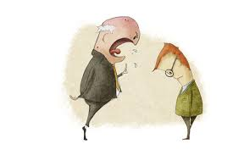

Abusive supervision
Abusive supervision occurs when individuals in a management role engage in a sustained display of hostile verbal and nonverbal behaviors to employees (Tepper, 2000).
Negative outcomes are well documented:
  Lower performance; Lower job satisfaction; Turnover intentions; Work family conflict; Deviance
Research predominantly focused on employees’ behavioural attempts to manage abuse:
  Constructive and destructive resistance behaviors, use of coping strategies, and engagement in upward hostility in response to abuse
However, employees’ emotional attempts to manage their abusive supervisor have not been considered

Slide 4



Expression vs faking emotions
Emotional Labor framework (Hochschild, 1983; Houston, Grandey & Sawyer, 2018)
Authenticity of expression and focus on discrete emotions
Glomb and Tews (2004) Discrete Emotions Emotional Labor Scale (DEELS) : (i) Genuine expression (ii) Faking and (iii) Suppression
  Authentic Expression – an emotion is felt by an individual and is expressed
  Faking (inauthentic) expression –an emotion is not felt but is expressed

Slide 5



Two emotions
Anger
Joy

Slide 6
Hypotheses
Abusive supervision and emotion expressions
H 1: Abusive supervision will be positively associated with authentic employee anger and negatively associated with authentic employee joy
H2: Abusive supervision will be positively associated with fake employee anger and fake employee joy
Emotion expression (authentic/faking) and performance
H3: Authentically expressed employee anger will be negatively associated with task proficiency and adaptivity
H4: Authentically expressed employee joy will be positively associated with task proficiency and adaptivity
H5: Fake employee anger and joy will be negatively associated with task proficiency and adaptivity
The mediating role of employees’ authentic and faked emotional expressions
H6: Authentically expressed employee anger and joy and fake employee anger and joy will mediate relationships between abusive supervision and task proficiency and task adaptivity.

Slide 7
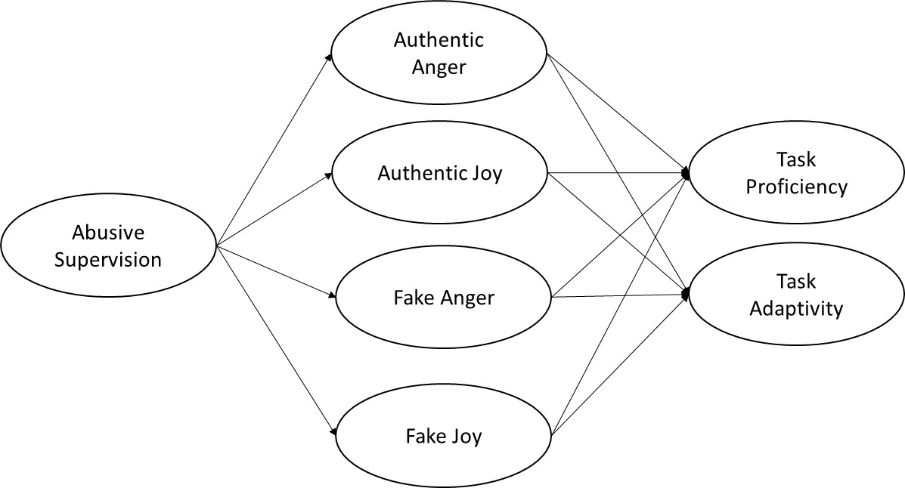

Slide 8
Method
Sample: 502 Australian employees, 18 years+, 20 hours of work +; same supervisor
Four waves of data, each 3 months apart
Time 1:
  Neuroticism (control)
  Performance: Team proficiency; team adaptivity (Griffin et al, 2007)
Time 2:
  IV: Abusive Supervision (Tepper, 2000 15 item measure)
Time 3:
  Mediators: Genuine expression of anger and joy; fake expressions of anger and joy (Glomb & Tews, 2004)
Time 4:
  DVs: Performance - team proficiency; team adaptivity (Griffin et al,, 2007)

Slide 9
Emotion expression measures
Authentic expressions
Describe how often you felt and expressed these emotions to your primary supervisor in the last three months. 5-point scale; 1=never to 5=many times a day.
Joy items (3-items) : Happiness, contentment, enthusiasm
Anger items (5-items): Irritation; dislike, anger, aggravation, hate
Faking expressions
Describe how often you expressed these emotions when you did not feel them to your primary supervisor in the last three months. 5-point scale; 1=never to 5=many times a day.
Joy items (3-items) : Happiness, contentment, enthusiasm
Anger items (5-items): Irritation; dislike, anger, aggravation, hate

Slide 10
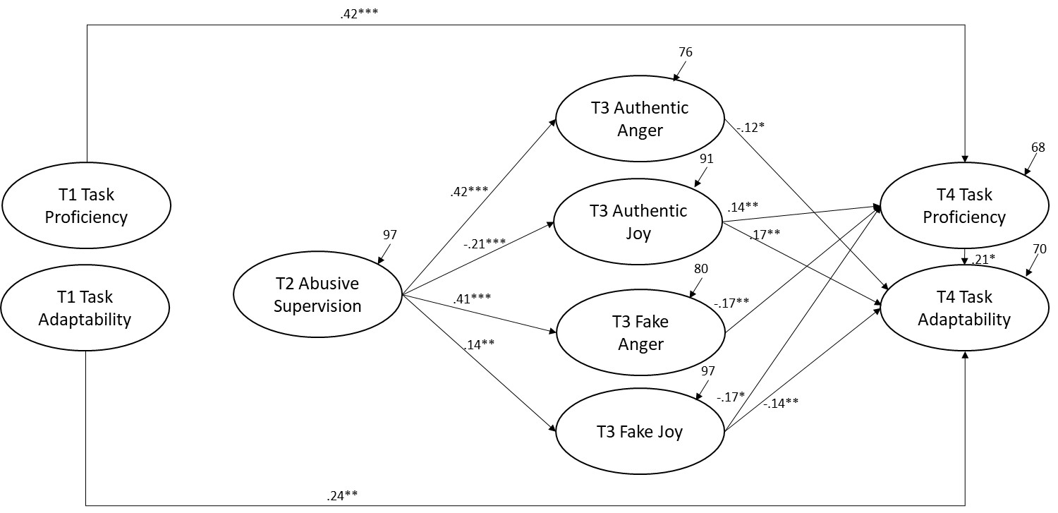
Figure 2
Indirect effects structural model results
Note: * p < .05, ** p < .01, *** p< .001. Relationships between T1 neuroticism and the study variables have been omitted to enhance the readability of the figure.

Slide 11

Overall Results and Future Directions
Employees experience and express authentic emotions in response to abusive supervision
Employees also fake emotional responses in response to abusive supervision
Both authentic and fake emotions predicted task proficiency and adaptivity
The increase in fake anger and joy as a result of abusive supervision points to the role of the individual in deciding how to regulate their emotions at work (Tamir, 2016).
Theoretical contributions
One reason employees may fake anger in response to abuse is to minimize the perception that they are a victim (Tepper et al., 2015)
Fake joy :1) self-enhancement (Tepper et al., 2015); 2) an appeasement; 3) display rules
Future Directions:
Examine employee motives behind expression of fake emotions in response to abusive supervision (Tamir, 2016)
Role of EI? Role of emotional display rules?
Other emotions? Contempt?

